Slide 1
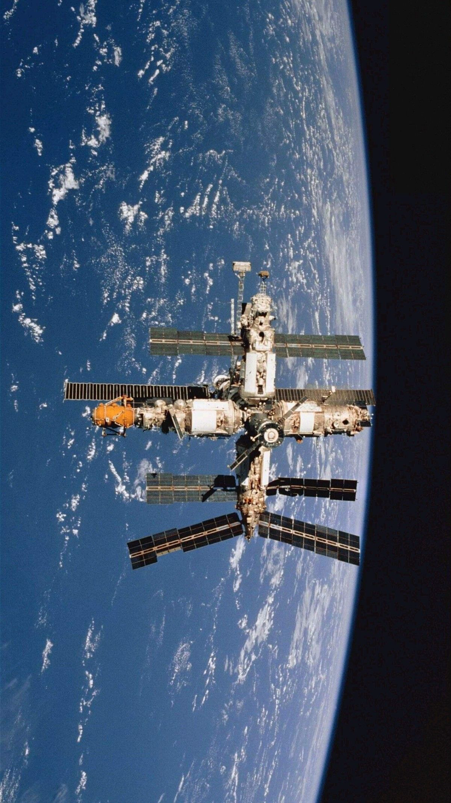

ASTROPHILES: What if the next medical breakthrough wasn't discovered on earth-but above it ?
JORDAN UNIVIRSITY OF SCIENCE AND TECHNOLOGY

Slide 2
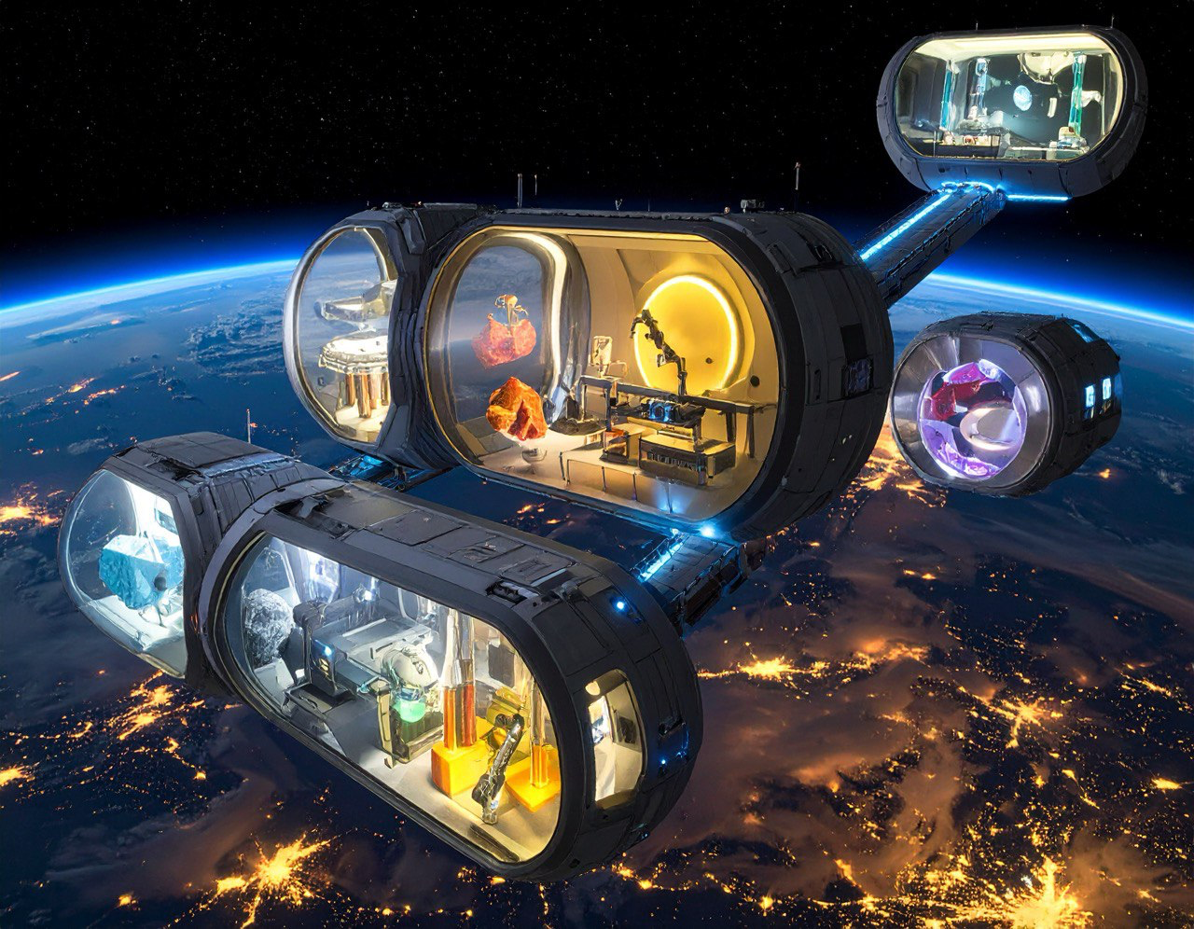
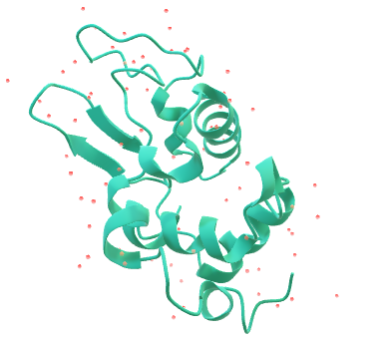
CONCEPT OVERVIEW
Our project uses space-based labs in Low Earth Orbit (LEO) to grow perfect protein crystals, which can speed up the development of new medicines.
By working in microgravity, we can get more accurate and higher-quality results than on Earth.
We are creating a modular, automated research unit that makes experiments in space cost-effective, repeatable, and scalable, opening new opportunities for both businesses and research institutions.

Slide 3
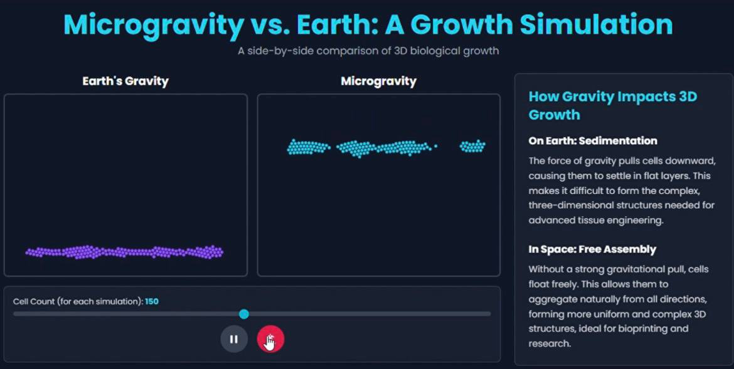
WHY MICROGRAVITY CHANGES SCIENCE ITSELF
No sedimentation or convection: Proteins crystallize slowly and uniformly.
• Larger, purer crystals: Essential for accurate structure analysis and drug design.
• 3D cell growth: Cells and tissues behave differently, revealing patterns not seen on Earth.
• Transformative research: Microgravity changes how we study molecular interactions, disease models, and drug discovery.

Slide 4
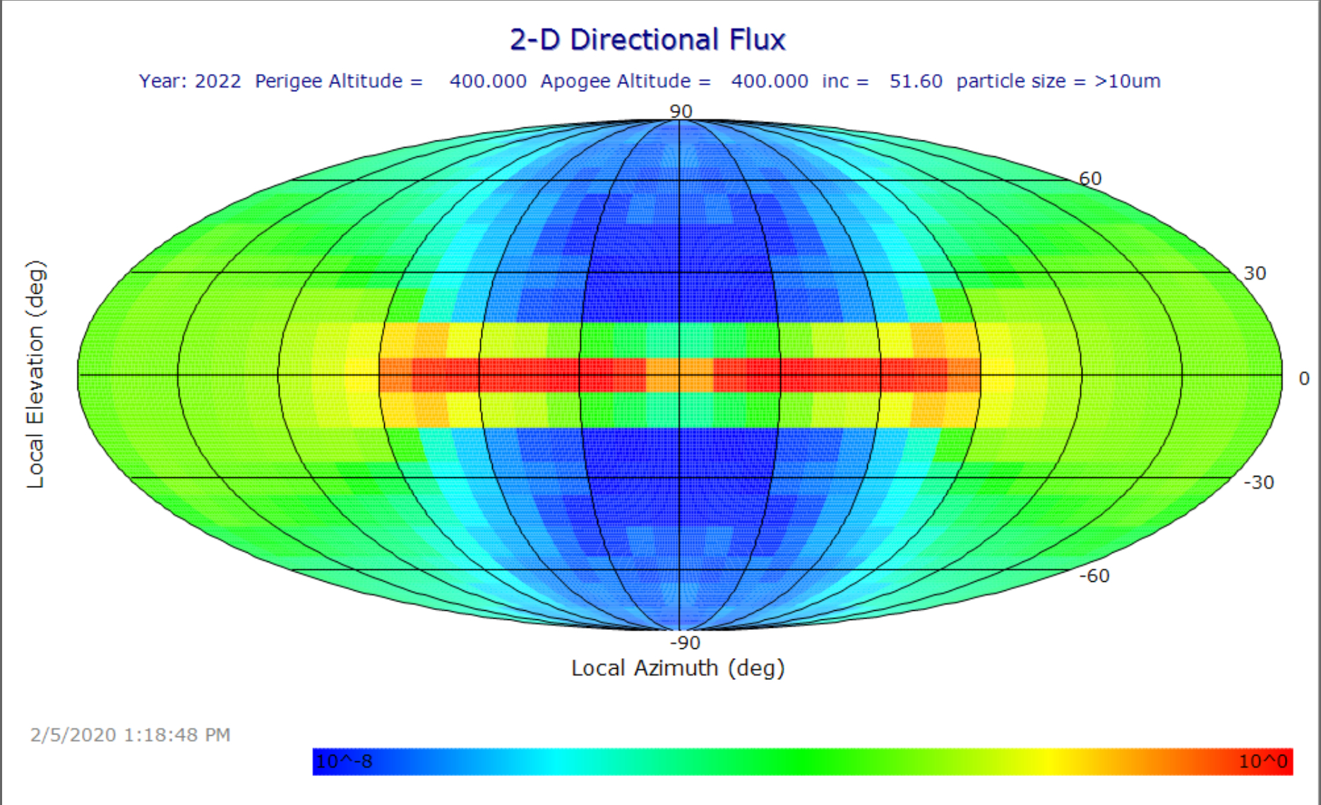
Learning from space debris-designing for the future
After the Cosmos–Iridium collision, thousands of new debris fragments were generated — increasing the long-term risk to orbital operations. To avoid similar threats, ASTROPHILES follows NASA’s orbital debris mitigation standards, ensuring: • debris-avoidance trajectory planning, • controlled orbit altitude selection, • and sustainable reusability of every module. Using directional flux data, our orbit is positioned within a low-risk corridor, minimizing collision probability while maintaining optimal communication and experiment stability
OREDM 3-directional average cross-sectional area flux for spacecraft assessment, mapped to 2-D directional flux projection.
*hot colors :high flux
*cool colors :low flux

Slide 5
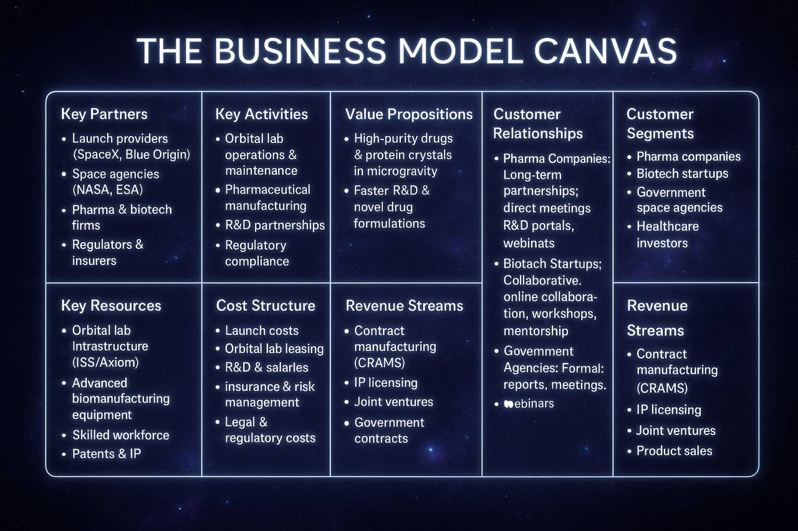
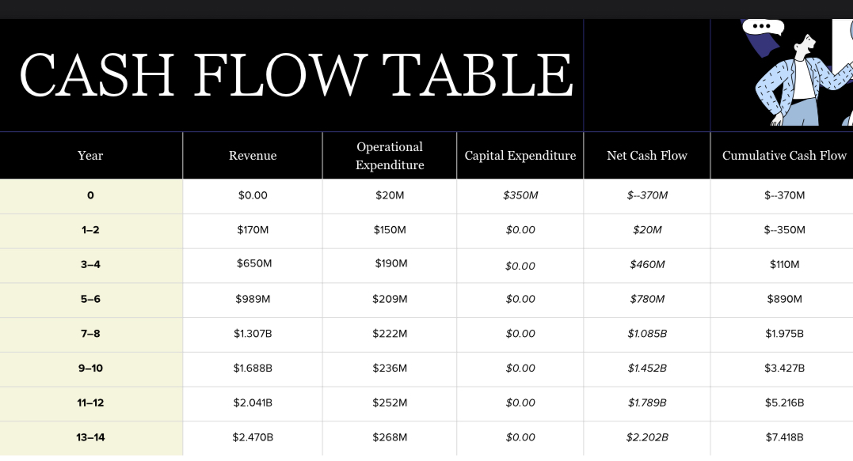
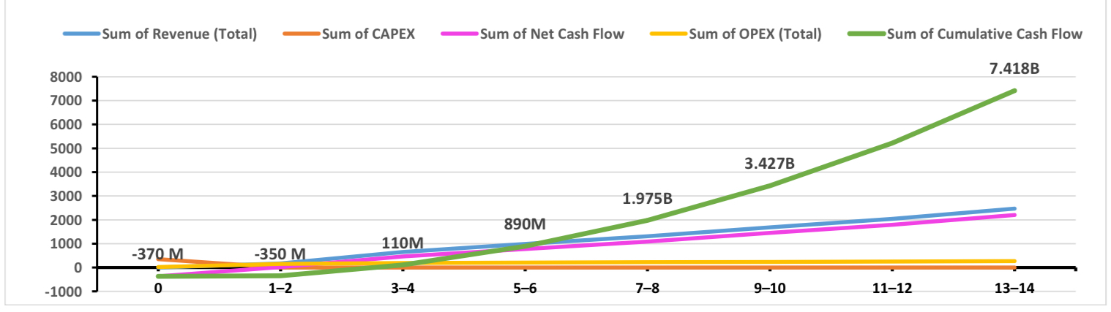
making space-based Reasearch accessible and profitable
Chash flow projection ​

Slide 6
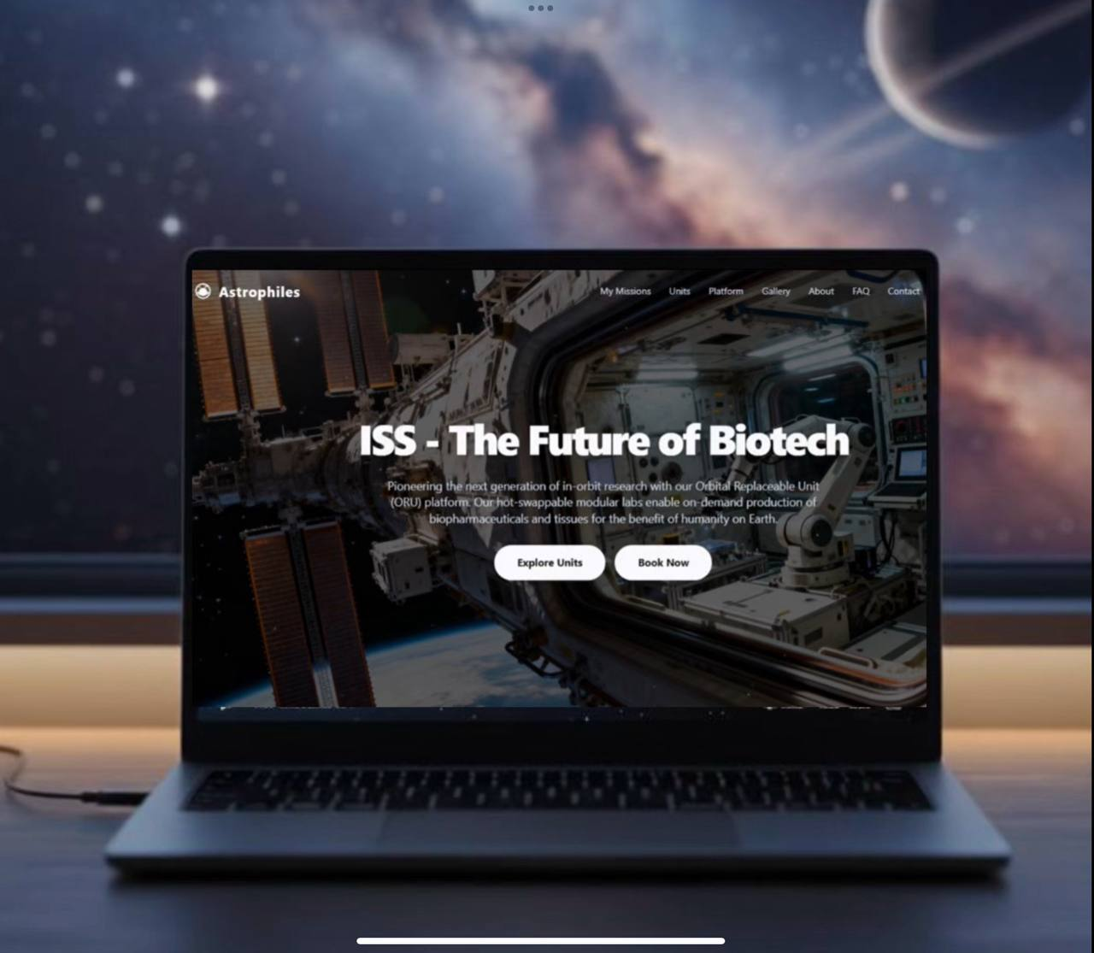
From orbit to earth:the Future of space-based Biotech
ASTROPHILES isn’t just a lab in orbit — it’s a digital gateway connecting Earth-based researchers to real-time space experiments.
🔹 Booking System: Researchers and biotech companies can reserve experiment slots directly via our platform.
🔹 AI Dashboard: Monitor, design, and analyze experiments remotely.
🔹 Data Revenue: Collected orbital data can be sold/licensed to institutions and pharmaceutical companies, creating a continuous revenue stream.
🔹 Expansion: Future modules include stem cells, tissue engineering, and biomaterials.

Slide 7
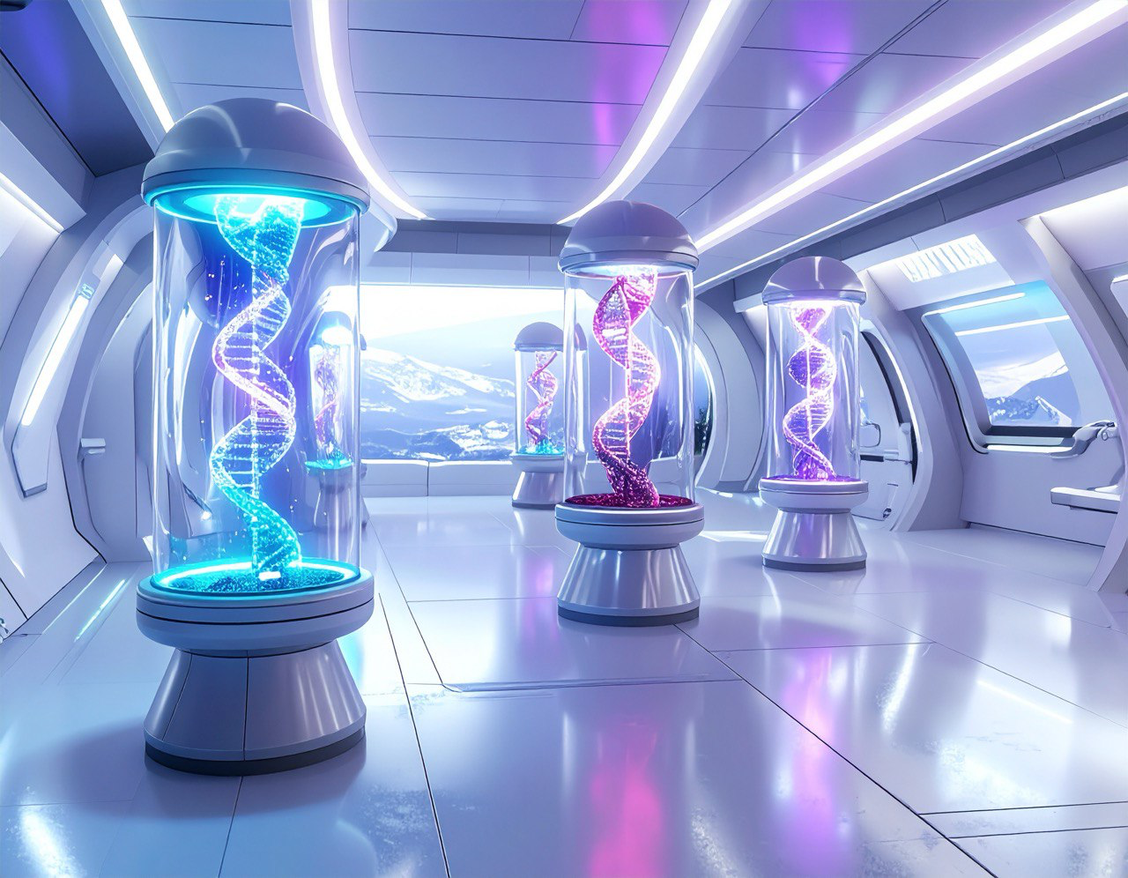
FUTURE VISION
Our LEO lab operates core modules conducting microgravity experiments. Next, we’ll expand with additional modules for stem cells, tissue engineering, and biomaterials. Data collected will feed a global marketplace, paving the way for a self-sustaining network of orbital labs
ASTROPHILES — Where Space Meets Life

